Slide 1


Aestra
Venture Viability Analysis
Western Mindanao State University, Zamboanga City

Slide 2

Aestra
We build AI-driven tools that simplify construction management, boost efficiency, and cut delays.
Western Mindanao State University, Zamboanga City

Slide 3
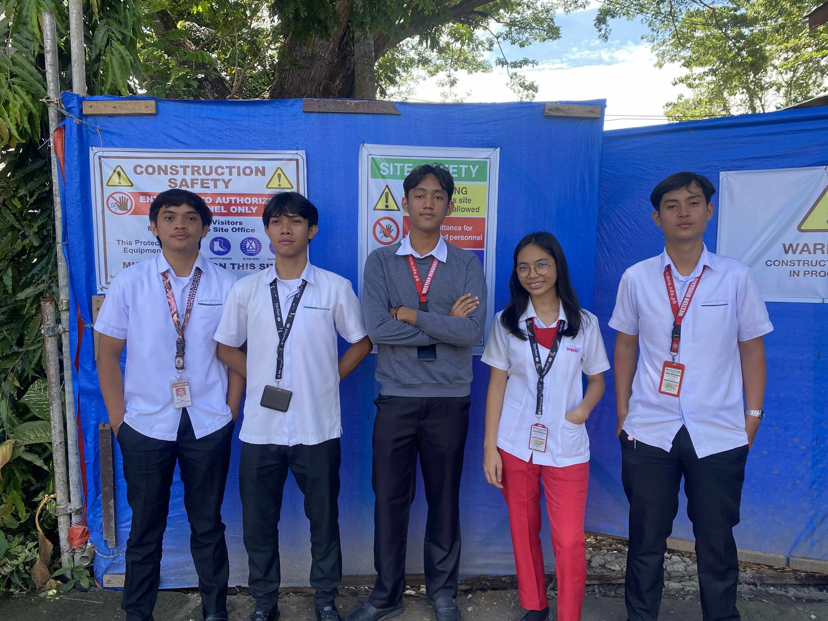
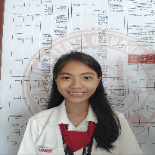
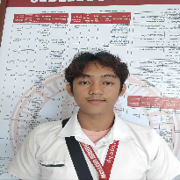
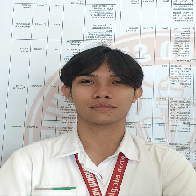
Venture Team
Name: Ma. Ericha Guanzon
Major: Computer Science
Name: Jude Brillantes
Major: Computer Science
Name: Sa'ad Bin Ain Jandul
Major: Computer Science
2

Slide 4
Context
48% of rework in construction comes from miscommunication and poor data, costing $31B
3

Slide 5

Problem Statement
Problem
A centralized system to manage workers, track progress, and improve communication, ensuring transparency, efficiency, and timely project completion.
Impact
Project managers face delays and stress, workers suffer from poor scheduling, and clients lose trust due to miscommunication, budget issues, and lack
4

Slide 6


Problem Statement/Industry
Problem Being Solved
The construction industry struggles with handling multiple projects at once due to scattered communication, poor worker tracking, and inconsistent reporting. These challenges lead to delays, budget overruns, and reduced client trust, making project management inefficient.
Supporting Data
48% of rework in construction comes from miscommunication and poor data, costing $31B
Source: Construction Disconnected report by PlanGrid in partnership with FMI Corporation (2018)
Area
Construction Project Management / Construction Support Services
Industry
Construction
Domain
Business Services

Slide 7





Problem Analysis
Affected Stakeholders
The ones most affected by this problem are project managers, who struggle to oversee multiple projects at once, as well as supervisors and workers, who face miscommunication and scheduling issues on-site.
Construction companies suffer delays, budget overruns, and reduced efficiency, while clients are affected by lack of transparency
Impact on Stakeholders
Project managers face stress from delays and poor data, supervisors struggle with scheduling, workers deal with confusion, companies risk budget overruns and delays, and clients experience frustration due to lack of transparency and late project completion, all lowering trust and efficiency in construction projects.
Root Causes
The problem exists due to reliance on manual processes, scattered communication through calls and texts, lack of centralized data management, inconsistent progress tracking, and delays in reporting material use and expenses. These issues create inefficiency, errors, and misalignment between teams and clients.
Personal/Team Connect
We want to work on this problem because one of our members personally experienced these struggles while working as an assistant to a Project Manager. We are motivated to address the lack of transparency and accountability in project handling, as issues like poor monitoring and unverified projects continue to arise.

Slide 8

Target Customer Segments
Primary
Architects, engineers, and construction project managers in urban construction firms
Secondary
Property owners and clients seeking real-time visibility into their construction projects
5

Slide 9

Customer Segment & Persona
Primary Segment
Architects, engineers, and construction project managers in urban construction firms
Persona
Secondary Segment
Property owners and clients seeking real-time visibility into their construction projects
Henry G. Fitzgerald Age in years: 32 Location: Metropolitan
Organizational Role: Contractor
(if applicable)

Slide 10
Customer Profile
Education: College pass out
Gender: Male
Occupation: Works for a private company
Interests/Hobbies: Travel
Primary Source of Information: Traditional Media (TV, Newspapers)
Shopping Preference: Hybrid Comfort with Technology: Medium Favourite Social Media: Facebook
Favourite Offline Gathering Spots: Local eateries or street food spots

Slide 11

Jobs-to-be-Done
Functional JTBD
He is a contractor and he wants to: Oversee multiple projects efficiently, Assigning the right people to the right tasks, Track daily progress transparently, Monitor budget and expenses in real- time, Manage material inventory across projects, Ensure workforce scheduling is clear, Improve communication with the team.
Emotional JTBD
He wants to feel in control, be confident in decision-making, feel less stressed, have peace of mind that the projects are progressing on schedule, feel secure financially, have a connection with the team, and be trusted, but most of all, he wants to feel accomplished that each project was delivered on time, within budget, and with good quality.
Social JTBD
Earn trust from clients, gain respect from workers and team members, be recognized by company owners/investors, be seen as a professional leader.

Slide 12


Current Alternatives
Current Alternatives
Manual spreadsheets, messaging apps, phone calls and SMS, paper-Based logs and reports, separate inventory logs, frequent site visits, email reports, accounting software.
Gaps in Current Alternatives
Contractors are dissatisfied with outdated tools, inconsistencies, and inefficient communication, leading to delays, inconsistencies, and ineffective project tracking, resulting in wasted time, decision-making delays, and client distrust.

Slide 13
Problem Validation (GOOTB)
Partial List of Potential Customers/Users Interviewed
Problem Validation
Total customers/users interviewed:
In-person: 9
Virtually: 2
Total customers/users for whom this problem is important to solve: 4
Total customers/users who are dissatisfied with the current alternatives: 0
Name: Ma. Nathanaela Guanzon
Occupation: Engineer
Name: Jomar F. Calderon
Occupation: Engineer
Name: Monica Alinabon
Occupation: Engineer

Slide 14
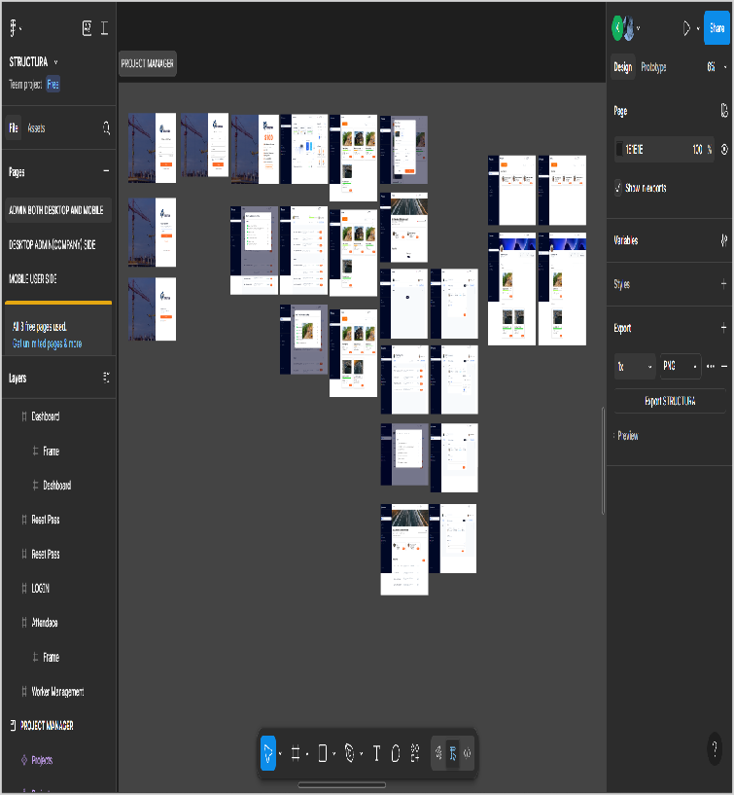
Our Solution
Solution
Develop a software to manage multiple construction projects with centralized communication, real-time worker tracking, and consistent reporting to prevent delays, cost overruns, and client distrust.
Core Technologies/ Methodologies
Frontend: Web & Mobile Flutter Backend: Django AI: TensorFlow Lite integration via plugins Database: MySQL
6

Slide 15


Solution Design
Our Solution
Develop a software to manage multiple construction projects with centralized communication, real-time worker tracking, and consistent reporting to prevent delays, cost overruns, and client distrust.
Key Features
Our system will feature multi-project dashboards, AI worker recommendations, attendance tracking, material monitoring, task reminders, document storage, progress tracking, and client updates.
Uniqueness
Our solution is unique as it’s built for construction, combining AI worker recommendations, real-time monitoring, progress tracking, & centralized communication to boost efficiency and accountability.
Solution Format:
Web-Based Platform and Mobile Application
Core Technologies/ Methodologies:
Frontend: Web & Mobile Flutter Backend: Django AI: TensorFlow Lite integration via plugins Database: MySQL

Slide 16

Solution Benefits
Functional Benefits
Easily manage multiple projects, track workers and materials, get AI-based workforce recommendations, share real-time updates with clients, and reduce delays and budget overruns through smart monitor
Emotional Benefits
Gain peace of mind with well-tracked projects, confidence in data-driven decisions, pride in on-time delivery, relief from delays and miscommunication, and stronger client trust through transparency.
Social Benefits
Earn client appreciation for transparency, gain recognition from bosses for efficiency, impress peers with AI-driven tools, & build a strong reputation for professionalism in the construction industry
Macro Benefits
Our AI-powered system boosts productivity, reduces delays and waste, creates reliable jobs, strengthens client trust, & drives economic growth while supporting a more sustainable construction industry

Slide 17


Competitors
Direct
Procore
Autodesk Construction Cloud
Indirect
ClickUp Asana
Our UVP
All-in-one platform for firms to track projects, logs, and workers saving time and improving.
7

Slide 18

Competitors
Direct Competitors
Procore
Indirect Competitors
ClickUp
Direct Competitors Globally
Autodesk Construction Cloud
Indirect Competitors Globally
Asana

Slide 19
Macro Analysis
Favourable Trends
AREA | DESCRIPTION
Technology | Rising digital transformation drives demand for project management platforms.
Other | Remote work trends boost need for efficient workforce and task management tools.
Unfavourable Trends
AREA | DESCRIPTION
Technology | Rising digital transformation drives demand for project management platforms.
Other | Remote work trends boost need for efficient workforce and task management tools.
Data Sources:
3 key insights on the digital transformation of construction — World Economic Forum (2025)

Slide 20
Back-of-the-Envelope Financial Projections
Currency: Philippine Peso (PHP)
Chosen Business Model: Subscriptions
AREA |  | YEAR 1 | YEAR 2 | YEAR 3
Revenues | 300000 | 600000 |  | 900000
Total Expenses | 800000 | 1039999 |  | 1247998
Profit | 500000 | 440000 |  | 348000

Slide 21
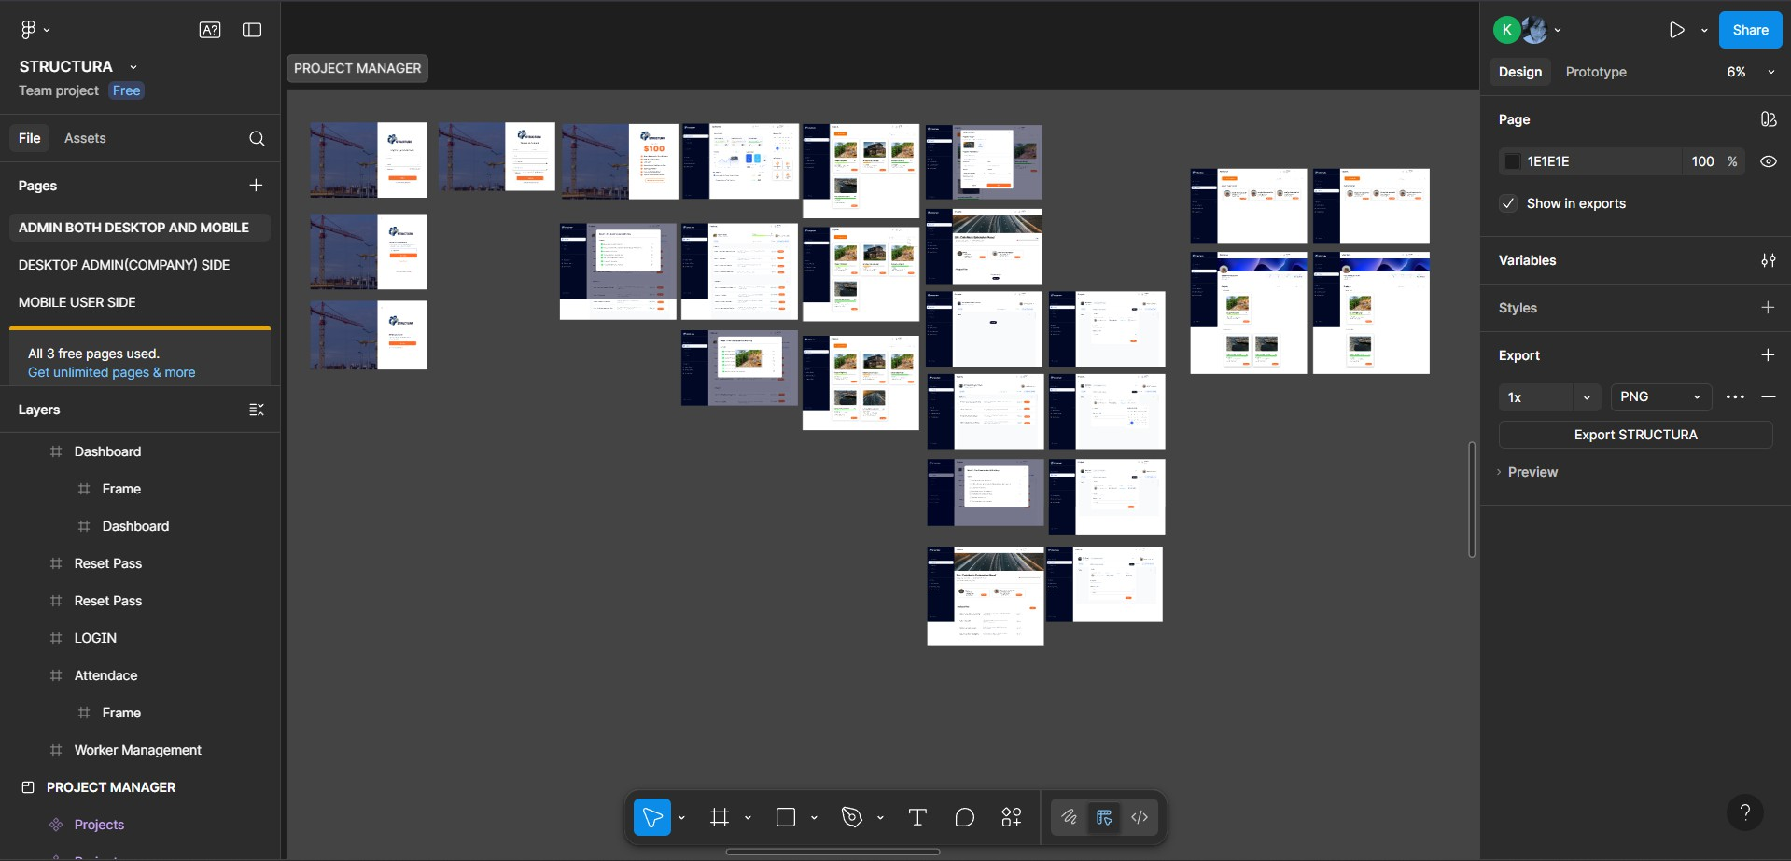
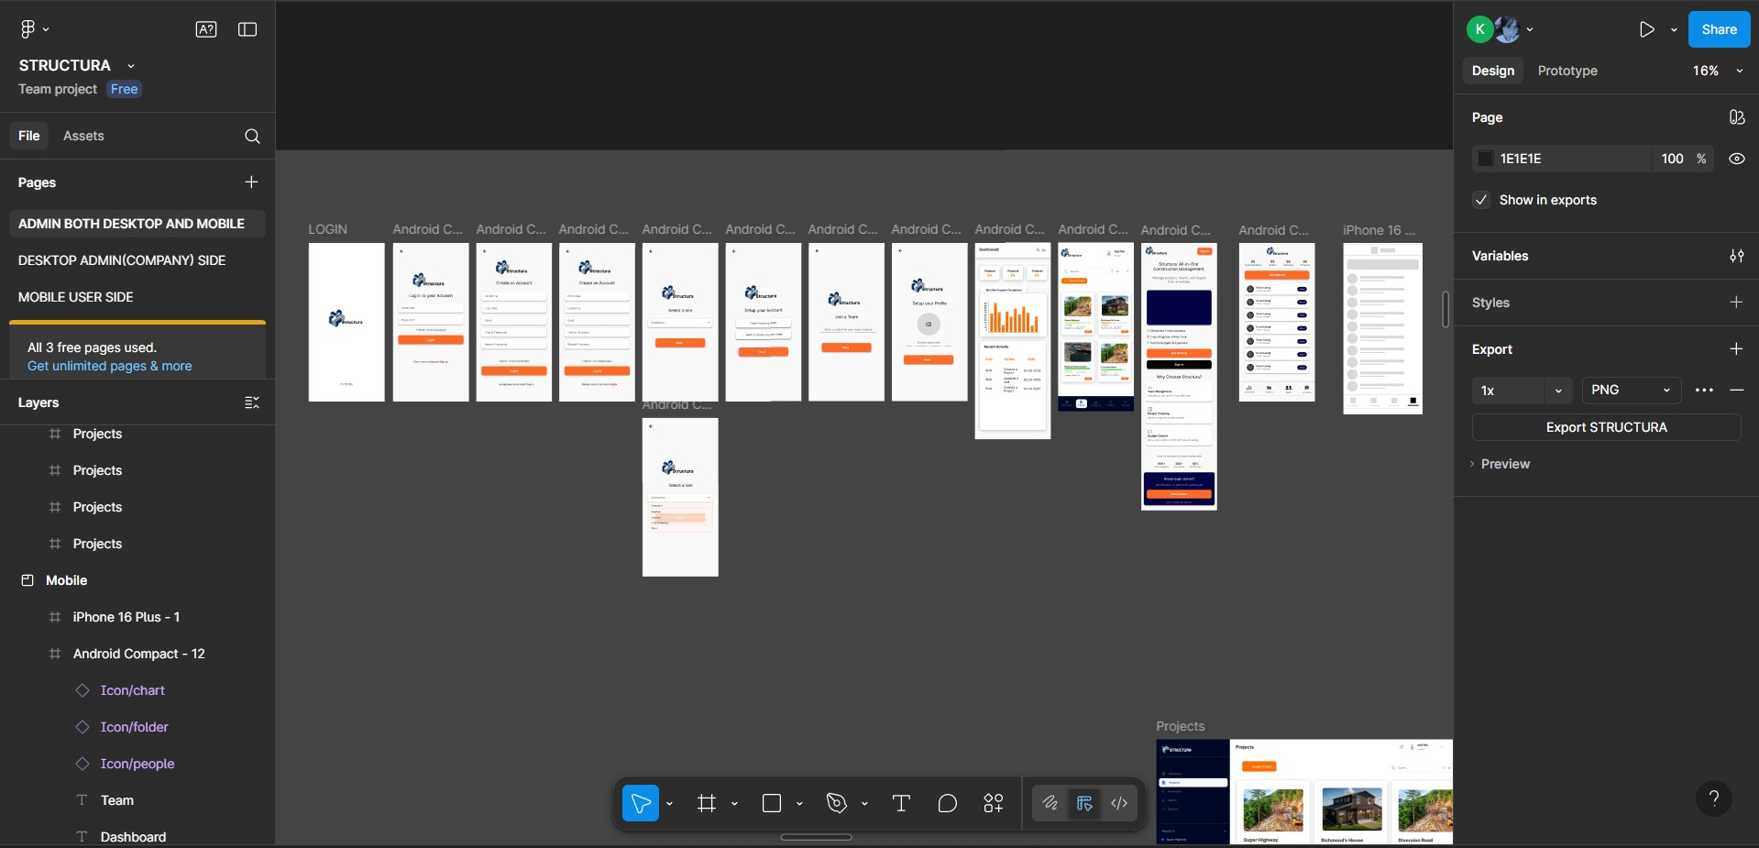
Prototype
Prototype Format
A web and mobile app prototype using figma
Functionality included in the Prototype
An app prototype that includes login/sign up process, dashboard for Project Manager/Supervisor/Client side, Workforce, attendance, project handling, project planner, clients portal, and many more
Functionality NOT included in the Prototype
adding of worker, creating a project and make a project plan, workers attendance, daily logs

Slide 22
Prototype Validation
Number of users engaged with?
3
How many people liked or loved the prototype?
3
How many people were either neutral or mostly unhappy with the prototype?
0
Prototype Feedback
What aspects of the prototype did the users LOVE? They particularly appreciate the feature that allows sending daily logs of ongoing projects directly through the site, as it helps ensure real-time progress tracking, transparency, and better project management. | What aspects of the prototype were DISLIKED by the users? They often remind us not to include the worker-adding feature on the supervisor’s side, emphasizing that only the firm should have the authority to add workers to ensure proper management and accountability.

Slide 23
Competition Analysis
COMPETITOR NAME | TYPE | STRENGTHS | WEAKNESSES
Procore | Direct | All-in-one construction tool | Pricey and hard to learn
ClickUp | Indirect | Flexible and affordable | Not for construction use
Autodesk Construction Cloud | Direct | Powerful BIM, global reach | Costly, complex to use
Asana | Indirect | Easy, flexible, scalable | Not construction-focused
Our Product/Service will be better than the competitors' solutions because:
All-in-one project, worker, and equipment management, Affordable and student-friendly subscription model, Real-time progress monitoring with visual dashboards

Slide 24
Market Size & GTM
GTM Channels | Digital Facebook Ads and Instagram - for reaching local construction firms and professionals. LinkedIn - to connect with project managers. SEO - to make our platform easily discoverable online.
 | Physical Flyers and brochures - distributed in universities, construction supply stores, and local government offices. Local radio ads - to reach contractors and firms in Zamboanga City.
Market Size
Globally: Construction Management
Software – $25B (2025)
Growth Rate: Annual Growth Rate: 26–36% CAGR (AI in
construct)
Source: Grand View Research, MarketResearch.com, Knowledge
8

Slide 25

Market Size
Total Addressable Market (TAM)
Construction Management Software – $25B (2025)
Serviceable Available Market (SAM)
Southeast Asia CMS Market – USD 2.5B (2025)
Serviceable Obtainable Market (SOM)
11,655,800
TAM
SAM
Assumptions
Targeting construction firms and contractors in the Philippines and Southeast Asia, focusing on small to mid-sized companies adopting digital project management tools., 5827.9,
2000
SOM
Sources of Research
Grand View Research, MarketResearch.com, Knowledge

Slide 26
Revenue Models / Pricing
Revenue Model (Primary)
Licensing Model
Revenue Model (Secondary)
Pay-per-Use Model

Slide 27





Lean Canvas
 | Solution Develop a software to manage multiple construction projects with centralized communication, real-time worker tracking, and consistent reporting to prevent delays, cost overruns, and client distrust. |  |  | Unfair Advantage Our competitive edge comes from our deep industry knowledge, exclusive system design for construction workflows, long-term partnerships with firms, and a trusted brand built on reliability.
Problem |  | Unique value |  |  | Customer
A centralized |  | Proposition |  |  | Segment
system to |  | All-in-one platform for |  |  | Architects,
manage |  | firms to track projects, |  |  | engineers, and
workers, track |  | logs, and workers saving |  |  | construction
progress, and |  | time and improving. |  |  | project
improve |  |  |  |  | managers in
communication, |  |  |  |  | urban
ensuring |  |  |  |  | construction
 |  |  |  | Channels We will distribute our system through direct B2B sales via our website, field partnerships with construction associations, and online demos with virtual onboarding for interested firms.
transparency, |  |  |  |  | firms,Property
efficiency, and |  |  |  |  | owners and
timely project |  |  |  |  | clients seeking
completion. | Key Metric Our key metrics include the number of subscribed firms, daily logged projects, renewal rate, reports generated per firm, |  |  |  | real-time visibility into their construction projects
 | customer satisfaction, and
 | overall system uptime
 | performance.
Cost Structure |  |  | Revenue Streams
Our main costs include system development, marketing, technical |  |  | Licensing Model, Pay-per-Use Model
support, staff salaries, and infrastructure such as servers, licensing,
domains, and SSL for secure and efficient operations.

Slide 28



Go-to-Market Approach
Geographic Focus
Zamboanga City as our pilot area. Expansion into neighboring Mindanao cities such as Pagadian, Dipolog, and Davao afterwards.
Digital Marketing Channels Facebook Ads and Instagram - for reaching local construction firms and professionals. LinkedIn - to connect with project managers. SEO
- to make our platform easily
discoverable online.
Marketing KPIs
Customer Acquisition Cost Conversion Rate Monthly Active Users Lead-to-Customer Ratio Customer Retention Rate Revenue Growth Rate
PRIMARY CUSTOMER SEGMENT
Architects, engineers, and construction project managers in urban construction firms
Physical Marketing Channels Flyers and brochures - distributed in universities, construction supply stores, and local government offices.
Local radio ads - to reach contractors and firms in Zamboanga
City.
UVP
All-in-one platform for firms to track projects, logs, and workers saving time and improving.
Competitors' GTM
Buildertrend - strong in online advertising and SEO, but lacks local presence andcommunity outreach.
Procore - uses LinkedIn and webinars effectively but focusesmainly on large-scale companies abroad.
GTM Partners
Local engineering and architecture associations for outreach and credibility. Digital marketing freelancers or agencies for social media campaigns.

Slide 29
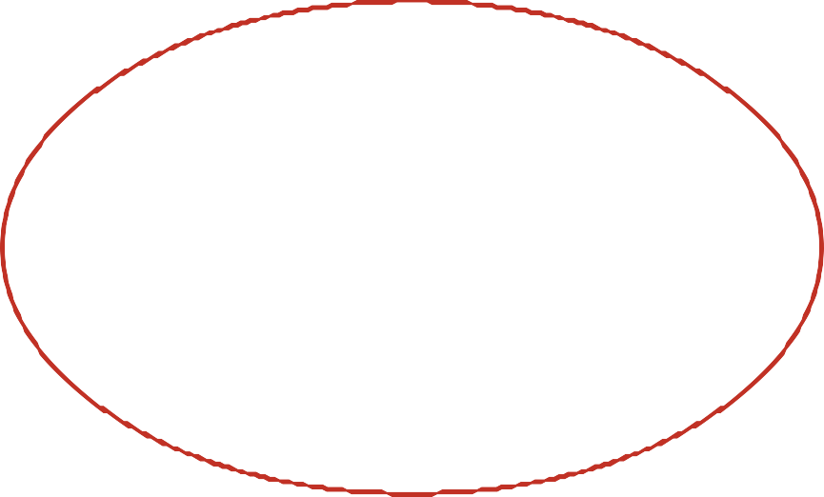
Sales & Customer Service
Customer Service
Email support
Distribution Channels We will distribute our system through direct B2B sales via our website, field partnerships with construction associations, and online demos with virtual onboarding for
interested firms.
Physical Sales Channels
Direct firm visits and partnership meetings with construction companies
PRIMARY CUSTOMER SEGMENT
Architects, engineers, and construction project managers in urban construction firms
Digital Sales Channels Landing page of the system including there is how it works and the advantages of using it
Sales KPIs
Revenue Growth – increase in subscriptions over time
UVP:
All-in-one platform for firms to track projects, logs, and workers saving time and improving.
structura- aestra.netlify.app
GTM Partners
Digital: Surveys (Google Forms) Offline: Focus group discussions or interviews with partner firms for detailed insights
https://drive.google.co m/drive/folders/1LHSf ET0gPuyqnIEnqaiG0M IvHlET6nZc

Slide 30
Financials
Revenue Models/Streams
Licensing Model Pay-per-Use Model
First Year Projections
Revenues: ₱27,472,804.84
Operating Profits:
₱22,718,980.46
Pricing
Unit of Sale: Subscription License
Selling price per unit: 5,000
pesos per year
9

Slide 31
Revenue Models / Pricing
Revenue Model (Primary)
Licensing Model
Unit of Sale
Subscription License
Sale Price per Unit
5,000 pesos per year
Expected units to be sold in Year 1
10 subscriptions
Expected growth in monthly sales
10% monthly growth rate

Slide 32
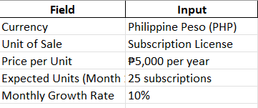
Costs & Revenues: Key Assumptions

Slide 33
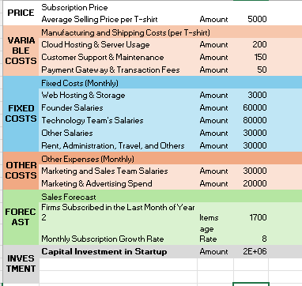
Profit & Loss Projections: Summary

Slide 34
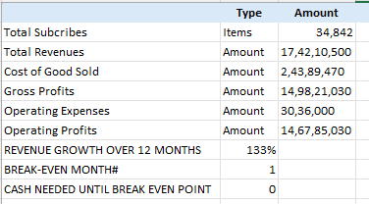
Performance & Break-Even Analysis
Year 1 Revenues ₱27,472,804.84 | Gross Profits for Year 1 ₱25,274,980.46
Net Profits for Year 1 ₱22,718,980.46 | Break-even Month 2nd

Slide 35

Next Steps
Goals for Months 10-12
Maintain and manage the system
Goals for Months 7-9
Product improvement/updates and scaling
Goals for Months 4-6
Product Advertisement
Goals for Months 1-3
Launch The System
10

Slide 36
Venture Viability Assessment
Venture Viability Index
77.77%
Strengths
Our key strengths include a well-structured revenue model, a smart pricing strategy, a highly skilled and motivated team, and the exceptional growth potential of our target industry.
Areas of Improvement
To thrive in a competitive marketplace, focus on understanding user needs and values. Enhance features and improve user experience by researching needs and listening to feedback. Increase marketing efforts to highlight unique features and outmarket competitors. This will boost customer satisfaction and establish the system as industry standard.

Slide 37
Next Steps
TIMELINE | GOALS | TEAM NEEDED | PHYSICAL RESOURCES NEEDED | FUNDS NEEDED
Months 1-3 | Launch The System | 2 coders | Mainframes | P5500
Months 4-6 | Product Advertisement | 5 marketer | Mainframes | P3000
Months 7-9 | Product improvement/updates and scaling | 5 coders | Mainframes | P5000
Months 10-12 | Maintain and manage the system | 5 debugger | Mainframes | P2000

Slide 38
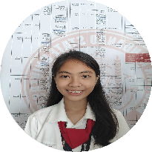
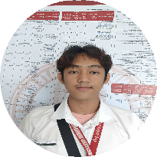
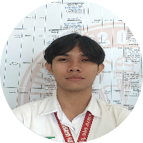
Venture Team
Name: Ma. Ericha Guanzon
University/College: Western Mindanao State University
Major:Computer Science
Key Skills: Programming, presenting. Role in the Venture: Lead Programmer Keen on continuing with the venture: Yes
Name: Jude Brillantes
University/College: Western Mindanao State University
Major:Computer Science
Key Skills: Analysis
Role in the Venture: Analyst
Keen on continuing with the venture:
Yes
Name: Sa'ad Bin Ain Jandul
University/College: Western Mindanao State University
Major:Computer Science
Key Skills: UX/UI Design, Presenting
Role in the Venture: UI/UX
Keen on continuing with the venture:
Yes
Current Mentors:
Engr. Marjorie Rojas and Mr. Rhamirl Jaafar
Mentors Needed in these Areas:
We need mentoring in several technical and system design areas.

Slide 39


Venture Summary
Mission
At Aestra, our mission is to deliver solutions built with focus, passion, and precision driven to exceed expectations and create lasting impact through innovation and excellence.
OVERVIEW
We at Structura are dedicated to transforming
the construction industry through an all-in-one digital platform that streamlines project and
workforce management. Our system centralizes worker tracking, material management, and
progress monitoring to help firms reduce delays, minimize errors, and improve transparency
among teams and clients.
Social/Economic Relevance
Focusing on this problem is important because improving
construction management through digital solutions promotes efficiency, accountability, and transparency, leading to more sustainable and organized project development.
2

Slide 40

Thank You!
At Aestra, our mission is to deliver solutions built with focus, passion, and precision driven to exceed expectations and create lasting impact through innovation and excellence.

